Slide 1
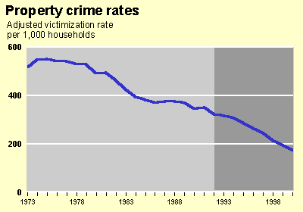
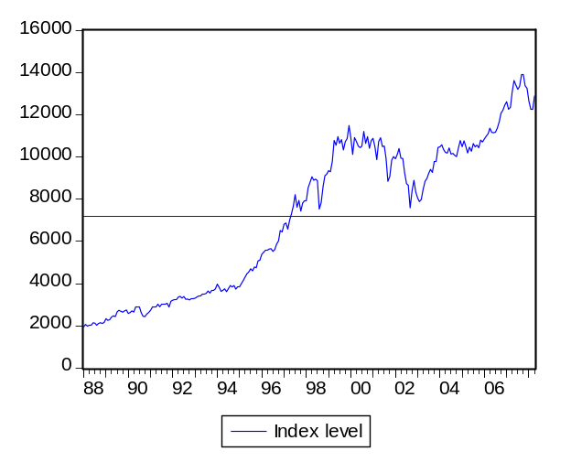
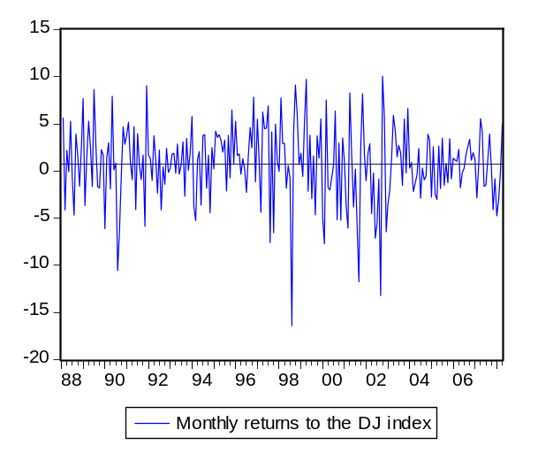
CHAPTER 3
STATISTICS AND TIME SERIES
Figure 3.1 Examples of Time Series
Dow Jones Index
González-Rivera: Forecasting for Economics and Business, Copyright © 2013 Pearson Education, Inc.

Slide 2


3.1 Stochastic Process and Time Series
Figure 3.2 Probability Density Function
pdf
12%
10
Y
González-Rivera: Forecasting for Economics and Business, Copyright © 2013 Pearson Education, Inc.

Slide 3



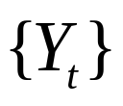



3.1.1 Stochastic Process
Figure 3.3 Graphical Representation of a Stochastic Process
2
……………..
t
1
T
González-Rivera: Forecasting for Economics and Business,
Copyright © 2013 Pearson Education, Inc.

Slide 4

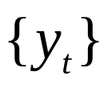


3.1.1 Time Series
Figure 3.4 Graphical Representation of a Stochastic Process
and a Time Series (Thick Line)
.
.
.
……….
2
……………..
t
1
T
González-Rivera: Forecasting for Economics and Business, Copyright © 2013 Pearson Education, Inc.

Slide 5
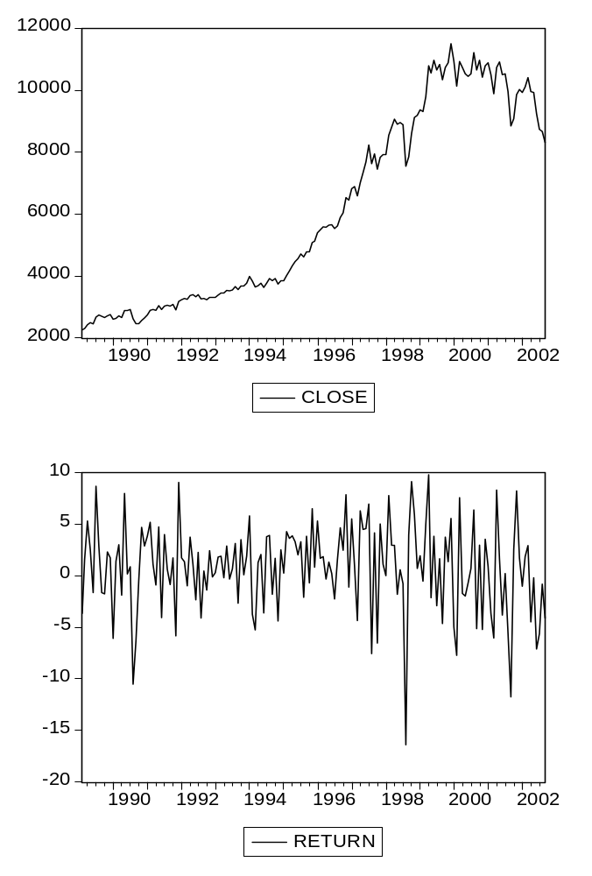



3.2.1 Stationarity
Figure 3.5 Nonstationary and Stationary Stochastic Process
Nonstationary
1
……………..
t
2
T
Stationary
1
……………..
t
2
T
González-Rivera: Forecasting for Economics and Business, Copyright © 2013 Pearson Education, Inc.

Slide 6
Figure 3.6 Strongly Stationary Stochastic Process
2
……………..
t
1
T
González-Rivera: Forecasting for Economics and Business, Copyright © 2013 Pearson Education, Inc.

Slide 7
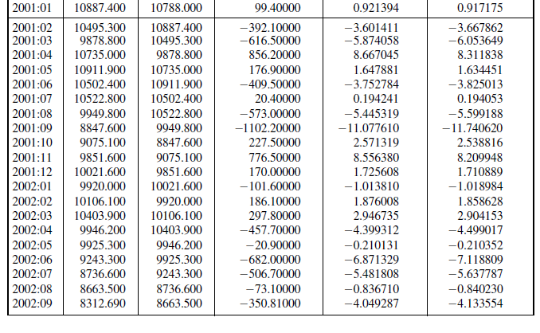
3.2.2 Useful transformations of Nonstationary Processes
Table 3.1 Dow Jones Index and Returns
Return = 100 X
(index-index(-1))/
Index(-1)
Return = 100 X
log(index)- log(index(-1))
First difference
Index-index(-1)
Date Index Index(-1)
González-Rivera: Forecasting for Economics and Business, Copyright © 2013 Pearson Education, Inc.

Slide 8
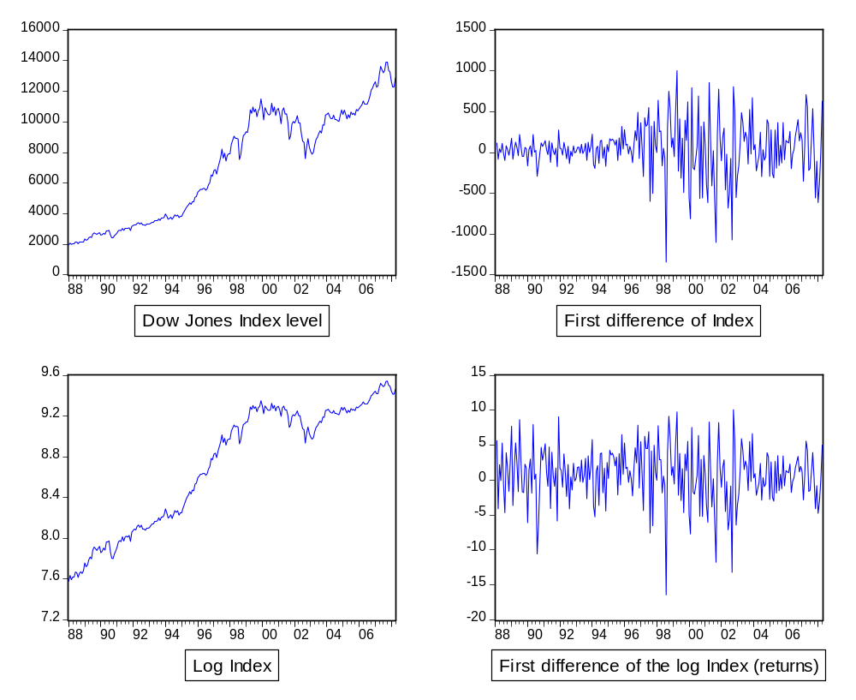
Figure 3.7 Dow Jones Index and Its Transformation to Returns
González-Rivera: Forecasting for Economics and Business, Copyright © 2013 Pearson Education, Inc.

Slide 9
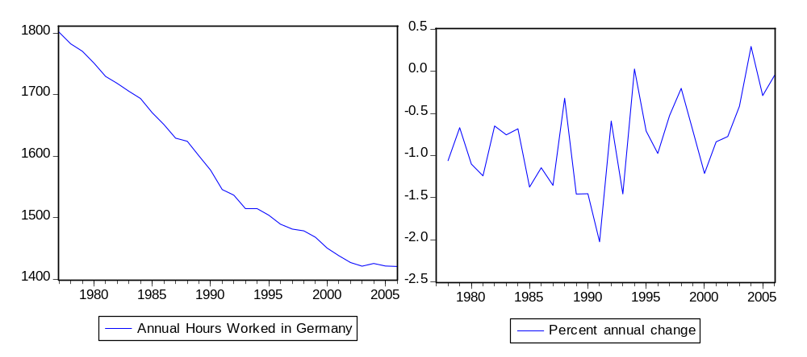
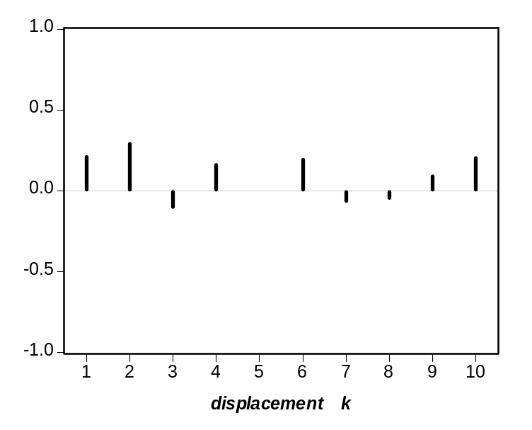

3.3 A New Tool of Analysis: The Autocorrelation Functions
Figure 3.8 Annual Hours Worked per Person Employed in Germany
Autocorrelation function
k | 1 | 2 | 3 | 4 | 5 | 6 | 7 | 8 | 9 | 10
 | .22 | .29 | -.10 | .16 | -.01 | .19 | -.06 | -.04 | .09 | .20
González-Rivera: Forecasting for Economics and Business, Copyright © 2013 Pearson Education, Inc.

Slide 10






Table 3.2 Percentage Change in Working Hours in Germany:
Calculation of the Autocorrelation Coefficients
1978 | -1.0604
1979 | -0.6699 | -1.0604
1980 | -1.1018 | -0.6699
1981 | -1.2413 | -1.1018 | -1.0604
1982 | -0.6497 | -1.2413 | -0.6699
1983 | -0.7536 | -0.6497 | -1.1018
1984 | -0.6826 | -0.7536 | -1.2413
1985 | -1.3733 | -0.6826 | -0.6497
1986 | -1.1438 | -1.3733 | -0.7536
1987 | -1.3533 | -1.1438 | -0.6826
1988 | -0.3196 | -1.3533 | -1.3733
1989 | -1.4574 | -0.3196 | -1.1438
1990 | -1.4536 | -1.4574 | -1.3533
1991 | -2.0234 | -1.4536 | -0.3196
1992 | -0.5904 | -2.0234 | -1.4574
1993 | -1.4550 | -0.5904 | -1.4536
1994 | 0.0264 | -1.4550 | -2.0234
1995 | -0.7087 | 0.0264 | -0.5904
1996 | -0.9752 | -0.7087 | -1.4550
1997 | -0.5249 | -0.9752 | 0.0264
1998 | -0.2026 | -0.5249 | -0.7087
1999 | -0.7057 | -0.2026 | -0.9752
2000 | -1.2126 | -0.7057 | -0.5249
2001 | -0.8375 | -1.2126 | -0.2026
2002 | -0.7745 | -0.8375 | -0.7057
2003 | -0.4141 | -0.7745 | -1.2126
2004 | 0.2950 | -0.4141 | -0.8375
2005 | -0.2879 | 0.2950 | -0.7745
2006 | -0.0492 | -0.2879 | -0.4141
Mean: | -0.8026
Variance: | 0.2905
(k= 1,3) |  | 0.0651 | -0.0282
(k= 1,3) |  | 0.2240 | -0.0970
González-Rivera: Forecasting for Economics and Business, Copyright © 2013 Pearson Education, Inc.

Slide 11
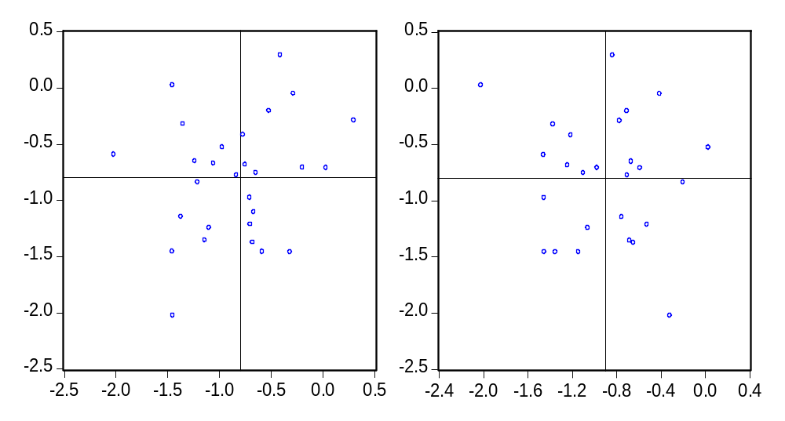



Figure 3.9 Percentage Change in Working Hours in Germany:
Autocorrelations of Order 1 and 3
González-Rivera: Forecasting for Economics and Business, Copyright © 2013 Pearson Education, Inc.

Slide 12
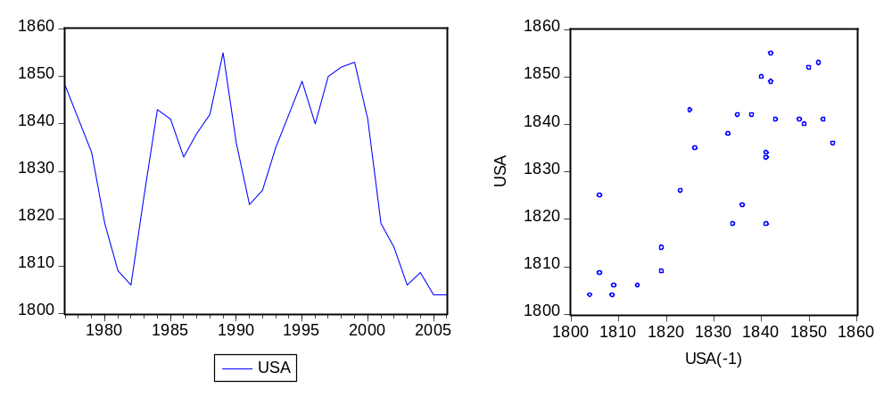
Figure 3.10 Annual Working Hours per Employee in the United States
Autocorrelation function
k | 1 | 2 | 3 | 4 | 5 | 6 | 7 | 8 | 9
 | .74 | .36 | .06 | -.09 | -.16 | -.29 | -.35 | -.25 | -.06
González-Rivera: Forecasting for Economics and Business, Copyright © 2013 Pearson Education, Inc.

Slide 13
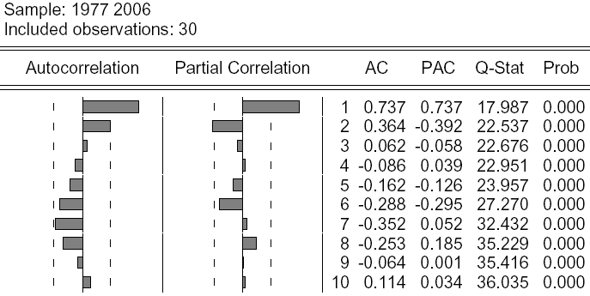
3.3.2 Statistical Tests for Autocorrelation Coefficients
Figure 3.11 Time Series: Annual Working Hours per Employee in
the United States. Autocorrelation Function
González-Rivera: Forecasting for Economics and Business,
Copyright © 2013 Pearson Education, Inc.

